Slide 1

A PREDICTIVE MODEL FOR NETWORK ATTACKS USING MACHINE LEARNING ALGORITHMS
NWONYIMA LESLIE ECHEZONA
20191163002
SUPERVISOR: ENGR. DR. E. C. AMADI

Slide 2
BACKGROUND INFORMATION
Cybersecurity threats have become more sophisticated, making traditional security methods less effective.
Organizations face significant financial and operational risks due to evolving cyber threats.
Machine Learning (ML) provides a proactive approach to detecting network anomalies.
ML analyses network traffic patterns to identify threats before they escalate.
This study employs Convolutional Neural Networks (CNNs) to develop a predictive security model.

Slide 3
STATEMENT OF PROBLEM
Existing network security measures are mostly reactive, relying on firewalls and signature-based intrusion detection systems.
These traditional methods struggle against novel and evolving threats.
Attackers now use Advanced Persistent Threats (APTs), zero-day exploits, and AI-driven cyberattacks to bypass conventional defenses.
As a result, organizations face increased financial losses, data breaches, and operational disruptions.
This study aims to develop a predictive model to forecast network attacks before they occur.
The goal is to enable proactive threat mitigation instead of reactive responses.

Slide 4
AIM AND OBJECTIVES
This study aims to develop a predictive model for network attacks using CNN, a machine learning algorithm. The specific objectives are:
To collect and preprocess network traffic data for analysis.
To identify relevant features that contribute to network attacks.
To evaluate various machine learning algorithms for predicting network attacks.
To develop and train a predictive model using the most effective algorithm.
To assess the performance of the model using standard evaluation metrics.
To provide recommendations for implementing the model in real-world network security systems.

Slide 5
SCOPE OF STUDY
This research focuses on developing a predictive model for network attacks using CNNs. The scope includes data collection, preprocessing, feature selection, model training, and evaluation. The study is limited to offline analysis and does not implement the model in a live production environment. However, it demonstrates the potential of ML-driven predictive models in enhancing network security.

Slide 6
SUMMARY OF LITERATURE REVIEW
Traditional machine learning models like Decision Trees, SVM, and KNN require extensive feature engineering.
Deep learning models such as CNNs and RNNs have shown promising results in detecting complex attack patterns.
Many prior studies overlook the importance of manual feature selection in optimizing model performance.
Unlike previous works that relied solely on automated feature extraction, this project used a Random Forest Classifier to determine feature importance.
Only the most relevant attributes were selected for CNN training.
While many studies stop at offline evaluation, this project includes a Streamlit-based API for practical usability.

Slide 7
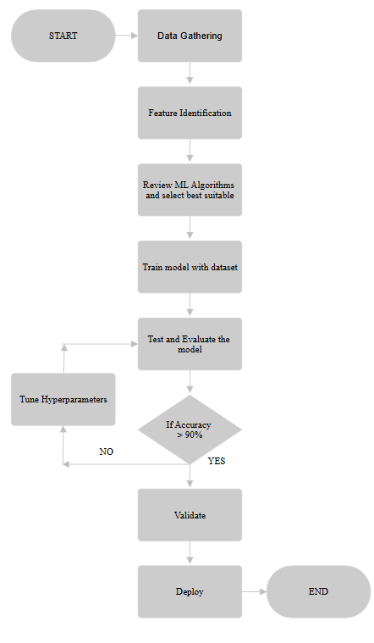
METHODOLOGY
The methodology follows a structured machine learning pipeline:
Data Collection
Feature Identification
Model Selection
Model Training
Evaluation
Deployment

Slide 8
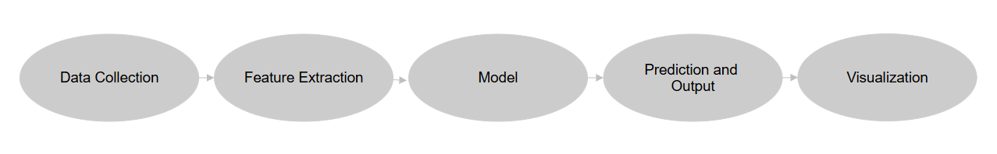
DESIGN MODELS
The system follows a multi-layered architecture:
Data Collection Layer: Gathers and preprocesses network traffic data.
Feature Extraction Layer: Selects key features that contribute to attack detection.
Model Layer: Implements a CNN-based deep learning model.
Prediction and Output Layer: Generates attack predictions based on input data.
Visualization Layer: Displays model outputs through a user-friendly interface.

Slide 9
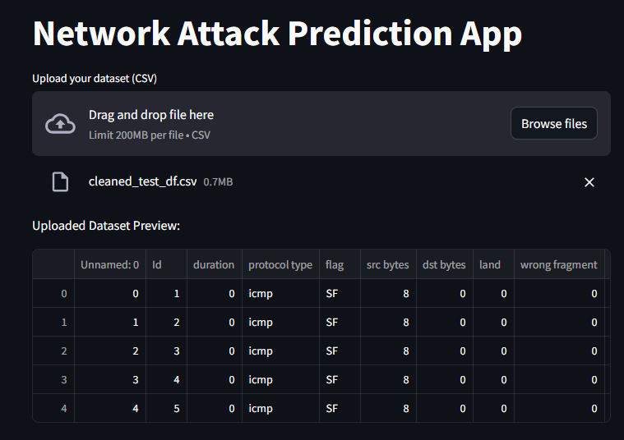
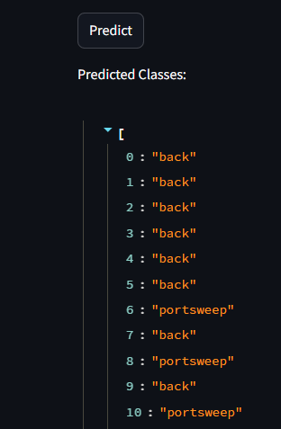
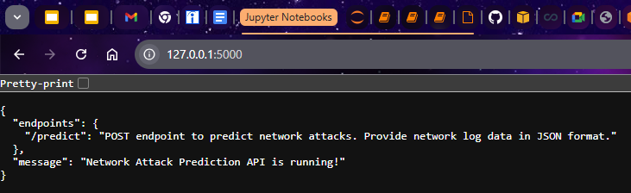
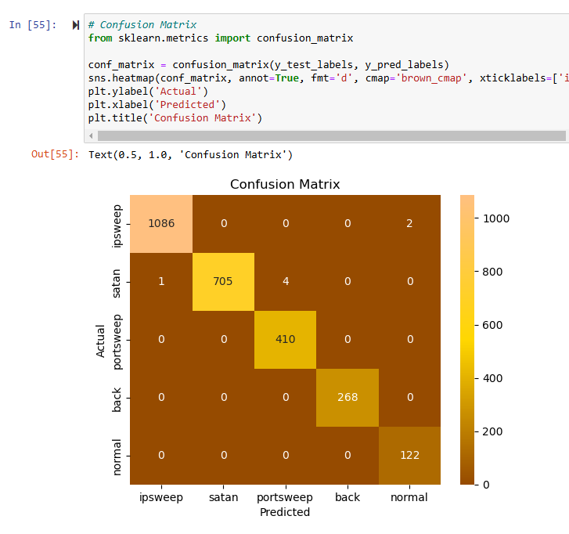
MAJOR FINDINGS/OUTPUTS
Manual feature selection using Random Forest improved CNN performance, ensuring that only the most critical attributes contributed to network attack detection.
CNN-based models outperformed traditional ML techniques, achieving high accuracy in detecting network attacks such as IPSweep, Satan, and PortSweep.
The model’s ability to learn spatial relationships between network features allowed it to distinguish between different attack types effectively.
The deployment of a Streamlit-based interface provided an interactive way to test the model and visualize predictions.
Hyperparameter tuning played a crucial role in enhancing the model’s generalization ability, improving its effectiveness across different attack patterns.
Streamlit-Based UI
Predicted Results
API Endpoint
Confusion Matrix

Slide 10
CONCLUSION AND RECOMMENDATION
The study demonstrates the effectiveness of CNNs in predicting network attacks with high accuracy. However, real-world deployment requires further enhancements such as real-time processing, hybrid ML approaches, and integration with threat intelligence platforms. Future research should explore adversarial defense mechanisms and continuous learning techniques to adapt to evolving cyber threats.

Slide 11
Thank you for listening

